Slide 1
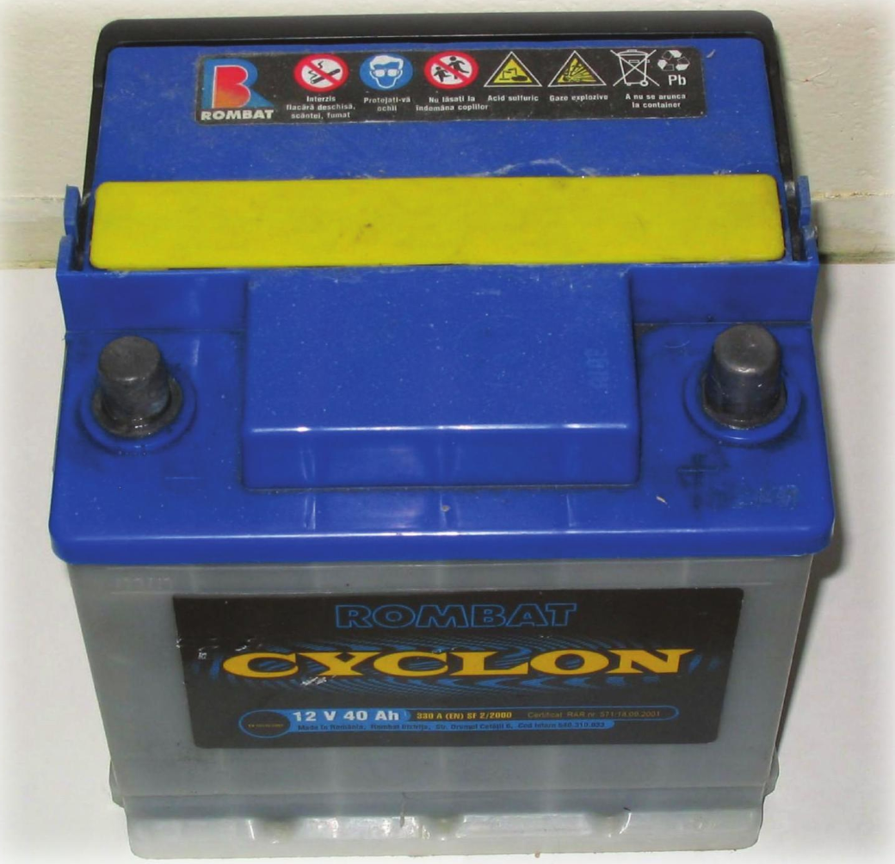
Electrochemistry = chemistry accompanied by the movement of electrons

Slide 2
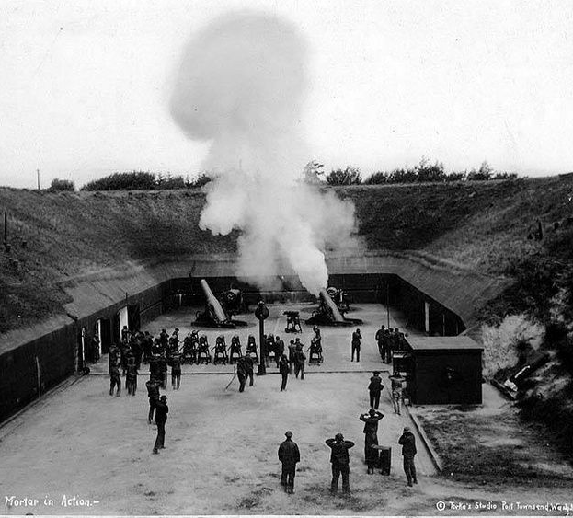
The word battery actually refers to multiple identical parts
Mortar
Electrical cell
A battery of mortars
(Pt. Townsend, 1915)
A battery of electrical cells

Slide 3
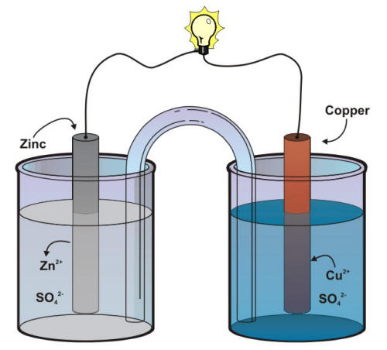
Electrical cells – which we’ll call Galvanic cells – have a long history
Volta’s cell
~1800
Daniell’s cell
early 1800s
Plante’s cell
mid 1800s
Leclanche’s cell
late 1800s

Slide 4
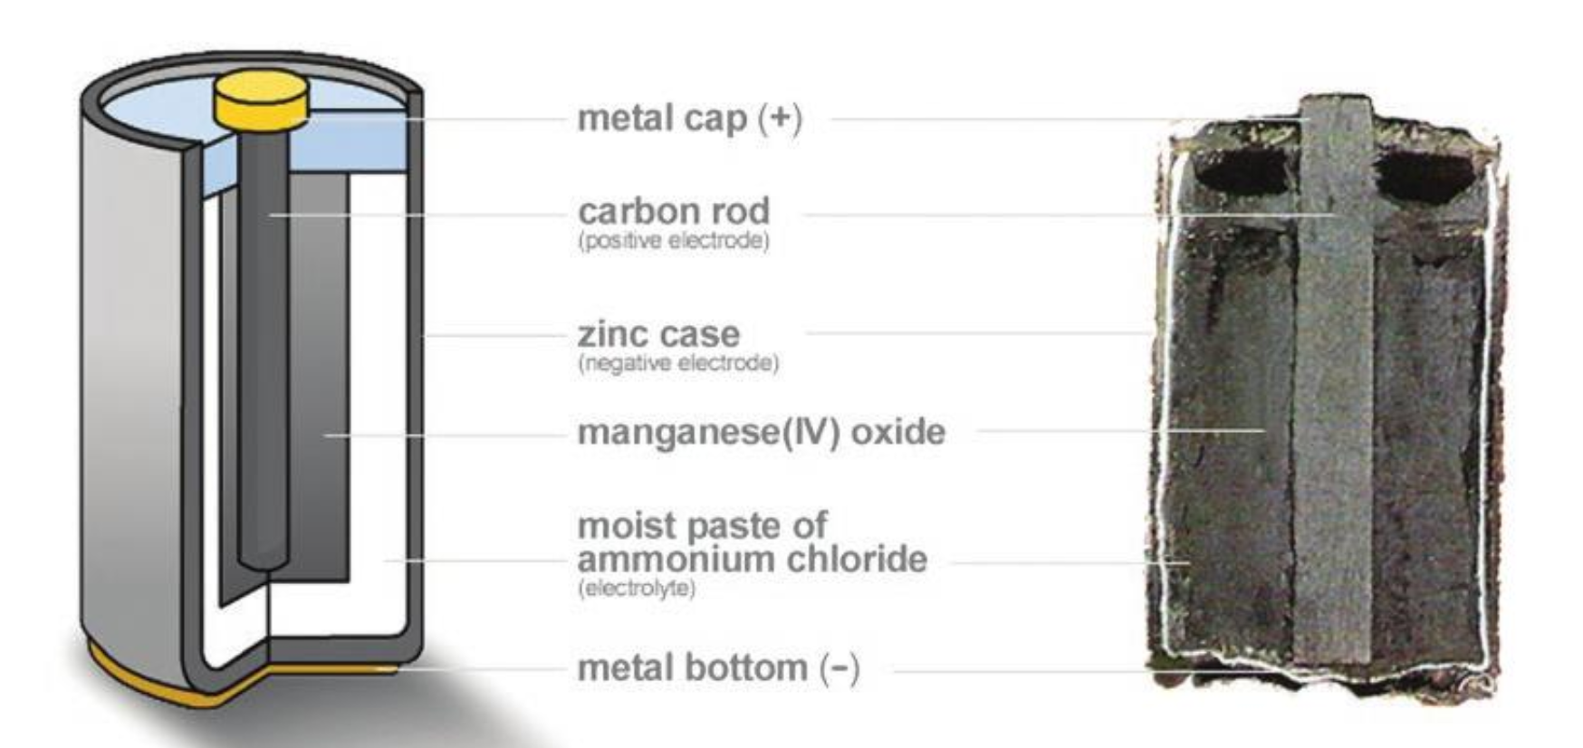

All Galvanic cells have an anode and a cathode
Electrons flow in at the cathode
Gassner’s cell
~1900
“Alkaline cell”
Electrons flow out at the anode

Slide 5
Which is the anode and which is the cathode in Daniell’s cell?

Slide 6
Which is the anode and which is the cathode in Daniell’s cell?
anode

Slide 7
Which is the anode and which is the cathode in Daniell’s cell?
anode
cathode

Slide 8
Different chemical reactions (“half-reactions”) occur at anode & cathode
anode
cathode
Zinc releases (loses) electrons
Copper consumes (gains) electrons

Slide 9
Different chemical reactions (“half-reactions”) occur at anode & cathode
“Leo says Ger”
anode
cathode
Zinc releases (loses) electrons
Copper consumes (gains) electrons

Slide 10
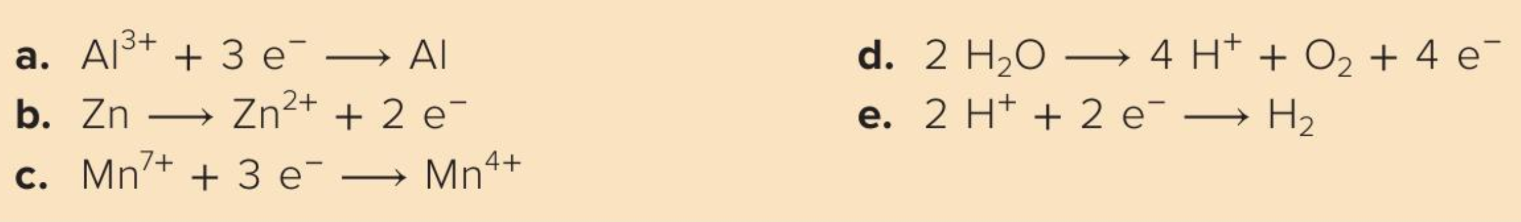
There are lots of possible oxidation & reduction half-reactions
is a …
…
…
…
…

Slide 11
There are lots of possible oxidation & reduction half-reactions
is a reduction half-reaction
…
…
…
…

Slide 12
There are lots of possible oxidation & reduction half-reactions
is a reduction half-reaction
is an oxidation half-reaction
…
…
…

Slide 13
There are lots of possible oxidation & reduction half-reactions
is a reduction half-reaction
is an oxidation half-reaction
is a reduction half-reaction
…
…

Slide 14
There are lots of possible oxidation & reduction half-reactions
is a reduction half-reaction
is an oxidation half-reaction
is a reduction half-reaction
is an oxidation half-reaction
…

Slide 15
There are lots of possible oxidation & reduction half-reactions
is a reduction half-reaction
is an oxidation half-reaction
is a reduction half-reaction
is an oxidation half-reaction
is a reduction half-reaction

Slide 16
Combining 1/2 reactions to form an overall balanced redox equation
oxidation
reduction
Overall redox
Conventions on writing overall balanced equations:
Cancel the electrons on left and right
If the same chemical species appears on both sides, leave them there

Slide 17
Combining 1/2 reactions to form an overall balanced redox equation
oxidation
reduction
Overall redox
Conventions on writing overall balanced equations:
Cancel the electrons on left and right (b/c they go through the wire)
If the same chemical species appears on both sides, leave them there

Slide 18
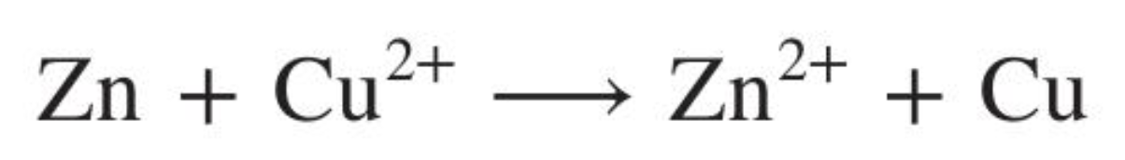
Combining 1/2 reactions to form an overall balanced redox equation
oxidation
reduction
Overall redox
Conventions on writing overall balanced equations:
Cancel the electrons on left and right (b/c they go through the wire)
If the same chemical species appears on both sides, leave them there

Slide 19
Overall balanced redox equations
Try these combinations:
b with e
reverse of b with reverse of e
a with the reverse of c
c with the reverse of a

Slide 20

Overall balanced redox equations
Try these combinations:
b with e
$$Zn+2H^{+}→Zn^{2+}+H_{2}$$
reverse of b with reverse of e
a with the reverse of c
c with the reverse of a

Slide 21

Overall balanced redox equations
Try these combinations:
b with e
$$Zn+2H^{+}→Zn^{2+}+H_{2}$$
reverse of b with reverse of e
$Zn^{2+}+H_{2}$ $→$ $Zn+2H^{+}$
a with the reverse of c
c with the reverse of a

Slide 22
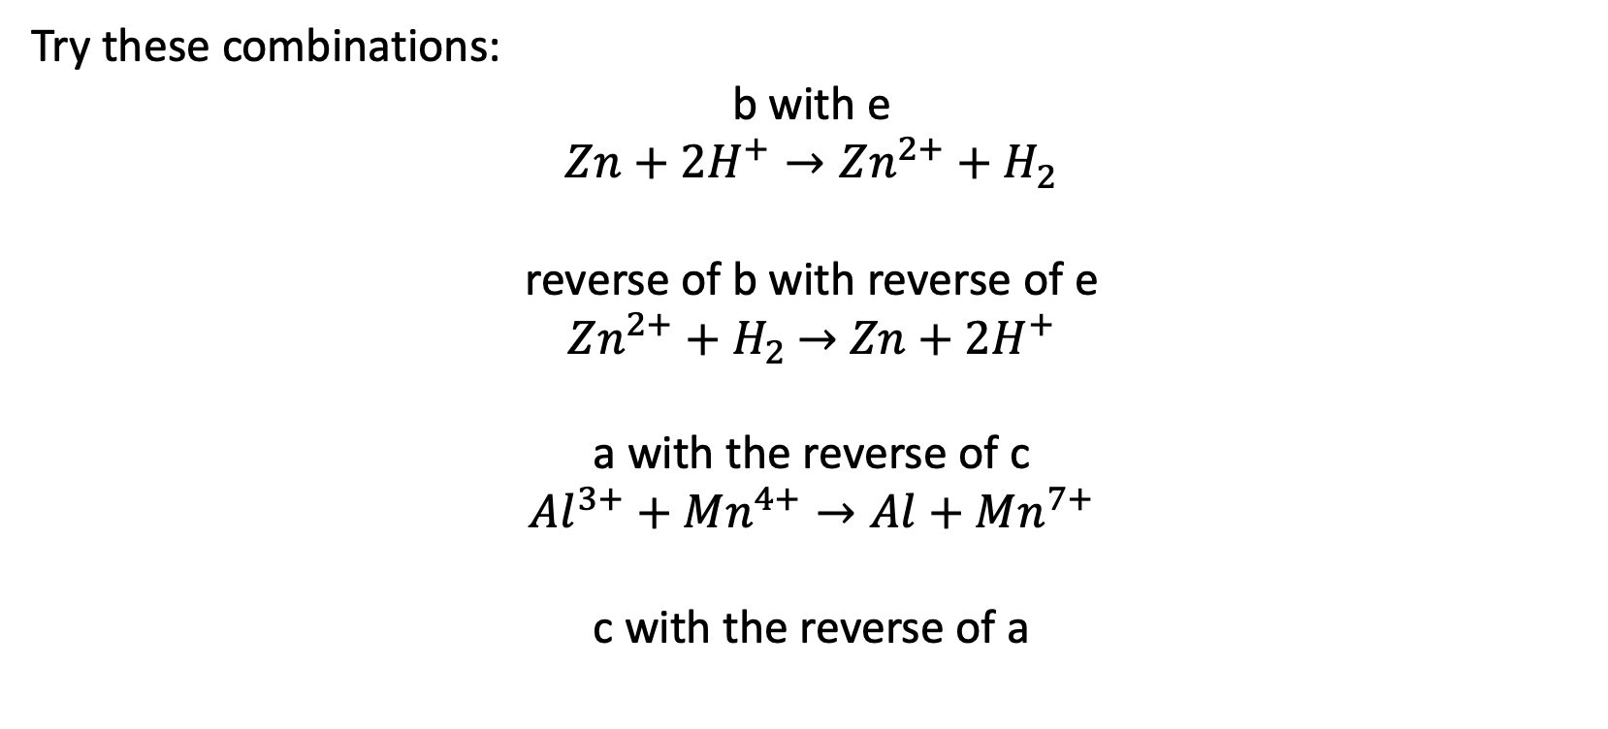
Overall balanced redox equations
Try these combinations:
b with e
$$Zn+2H^{+}→Zn^{2+}+H_{2}$$
reverse of b with reverse of e
$Zn^{2+}+H_{2}$ $→$ $Zn+2H^{+}$
a with the reverse of c
$$Al^{3+}+Mn^{4+}→Al+Mn^{7+}$$
c with the reverse of a

Slide 23
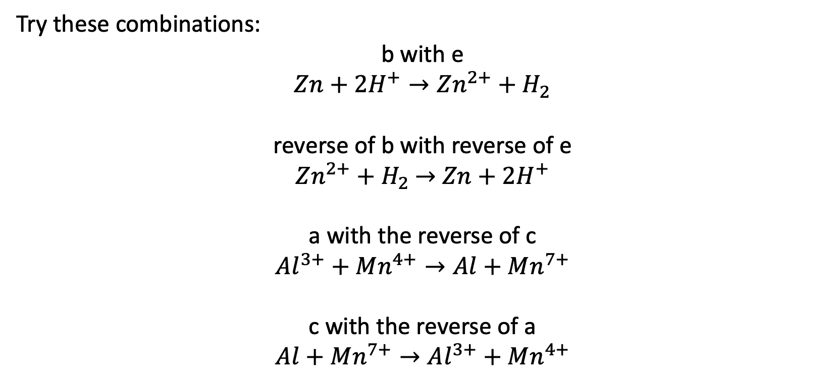
Overall balanced redox equations
Try these combinations:
b with e
$$Zn+2H^{+}→Zn^{2+}+H_{2}$$
reverse of b with reverse of e
$Zn^{2+}+H_{2}$ $→$ $Zn+2H^{+}$
a with the reverse of c
$$Al^{3+}+Mn^{4+}→Al+Mn^{7+}$$
c with the reverse of a
$$Al+Mn^{7+}→Al^{3+}+Mn^{4+}$$

Slide 24

Overall balanced redox equations
Sometimes, combinations require balancing the electrons:
a with b
$$2 Al^{3+}+6{ e}^{−}→2 Al$$
$3 Zn→$ $3 Zn^{2+}+6 e^{−}$
------------------------------------------

Slide 25

Overall balanced redox equations
Sometimes, combinations require balancing the electrons:
a with b
$$2 Al^{3+}+6{ e}^{−}→2 Al$$
$3 Zn→$ $3 Zn^{2+}+6 e^{−}$
------------------------------------------

Slide 26

Overall balanced redox equations
Sometimes, combinations require balancing the electrons:
a with b
$$2 Al^{3+}+6{ e}^{−}→2 Al$$
$3 Zn→$ $3 Zn^{2+}+6 e^{−}$
------------------------------------------
$$2 Al^{3+}+3 Zn→2 Al+3 Zn^{2+}$$

Slide 27
Overall balanced redox equations
Sometimes, combinations require balancing the electrons:
d with e
------------------------------------------
Conventions on writing overall balanced equations:
Cancel the electrons on left and right
If the same chemical species appears on both sides, leave them there

Slide 28

Overall balanced redox equations
Sometimes, combinations require balancing the electrons:
d with e
$$2 H_{2}O→4{ H}^{+}+O_{2}+4 e^{−}$$
$$4{ H}^{+}+4 e^{−}→2 H_{2}$$
------------------------------------------
Conventions on writing overall balanced equations:
Cancel the electrons on left and right
If the same chemical species appears on both sides, leave them there

Slide 29
Overall balanced redox equations
Sometimes, combinations require balancing the electrons:
d with e
$$2 H_{2}O→4{ H}^{+}+O_{2}+4 e^{−}$$
$$4{ H}^{+}+4 e^{−}→2 H_{2}$$
------------------------------------------
Conventions on writing overall balanced equations:
Cancel the electrons on left and right
If the same chemical species appears on both sides, leave them there

Slide 30

Overall balanced redox equations
Sometimes, combinations require balancing the electrons:
d with e
$$2 H_{2}O→4{ H}^{+}+O_{2}+4 e^{−}$$
$$4{ H}^{+}+4 e^{−}→2 H_{2}$$
------------------------------------------
$$2 H_{2}O+4 H^{+}→4 H^{+}+O_{2}+2 H_{2}$$
Conventions on writing overall balanced equations:
Cancel the electrons on left and right
If the same chemical species appears on both sides, leave them there

Slide 31
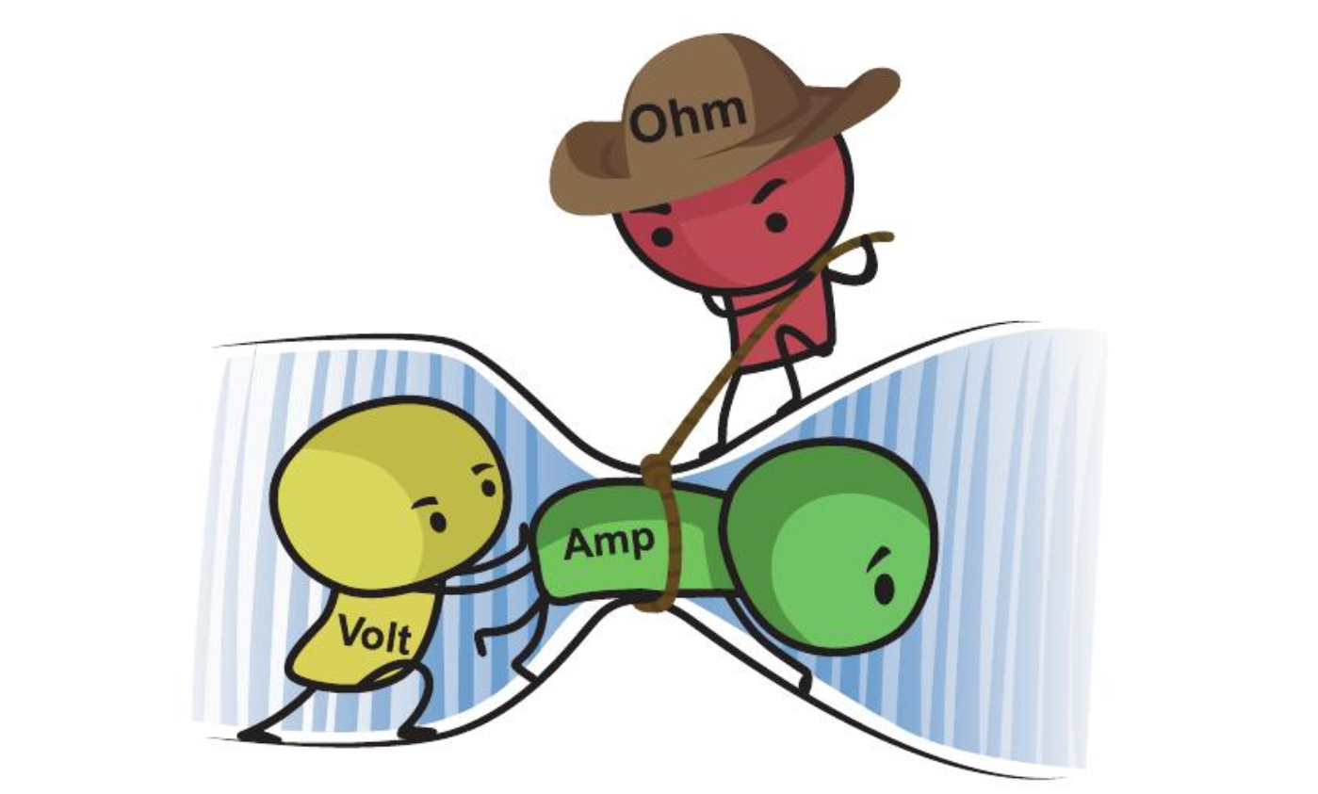
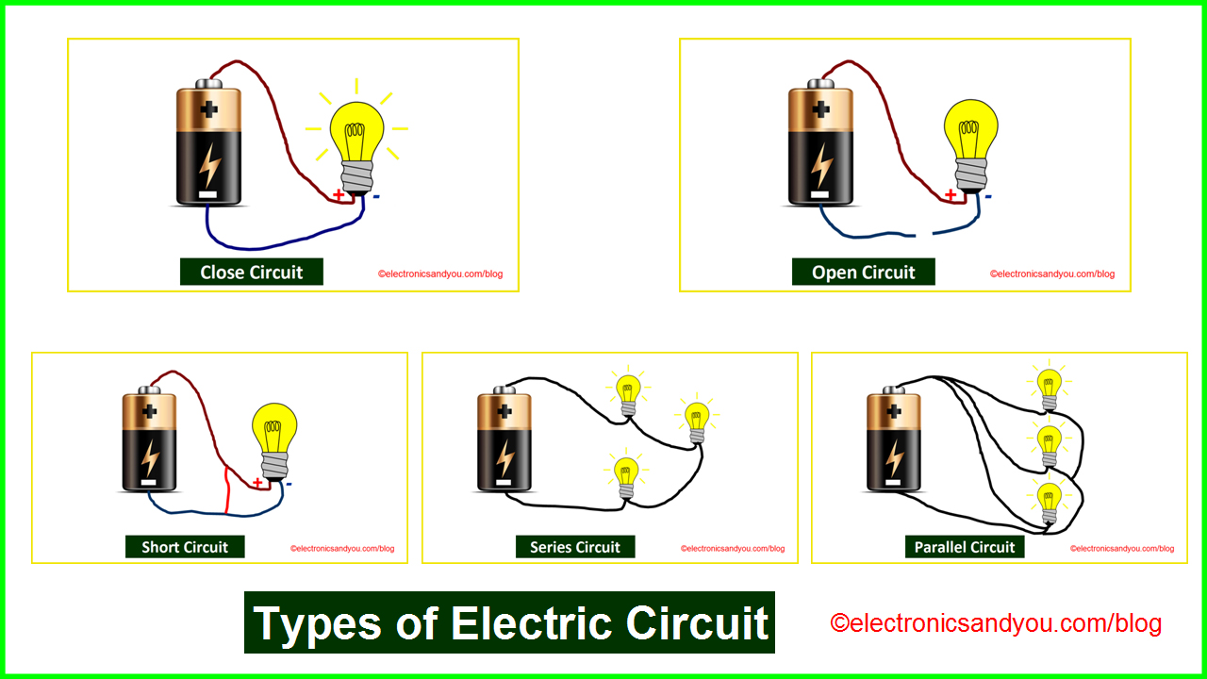
Electrical current
Current (I) is like flow
Units are “Amperes”
You can tell the current in a light bulb by its brightness

Slide 32
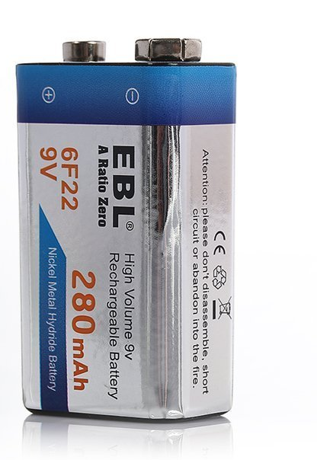
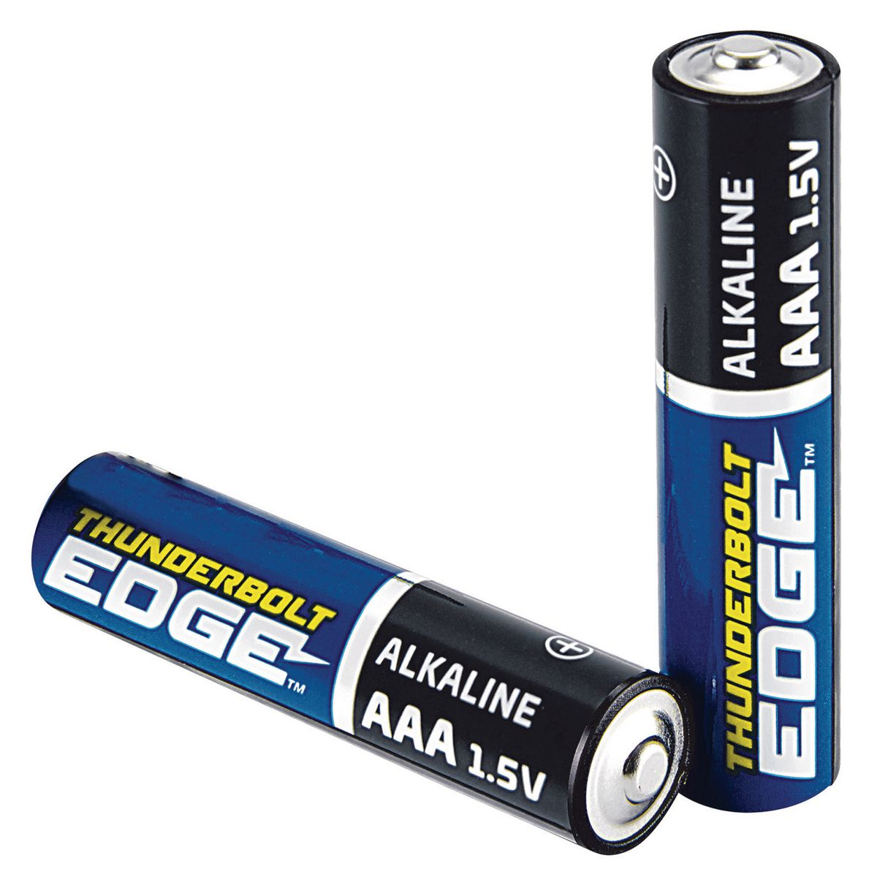
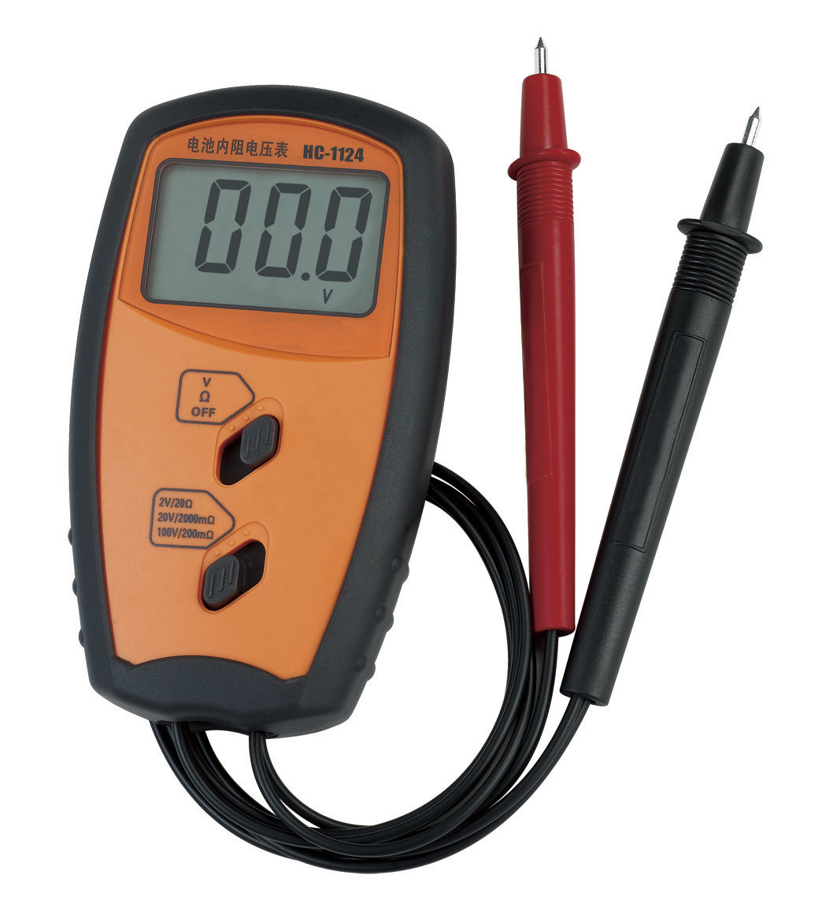
Voltage
Voltage (V) is like pressure
Units are “Volts”
You can tell the voltage from the label on the battery (or use a voltmeter)

Slide 33
Resistance
Resistance (R) is like friction
Units are “Ohms”
More in a series => more resistance
R of 1 lightbulb

Slide 34
Resistance
Resistance (R) is like friction
Units are “Ohms”
More in a series => more resistance
R of 1 lightbulb
3x the original resistance

Slide 35
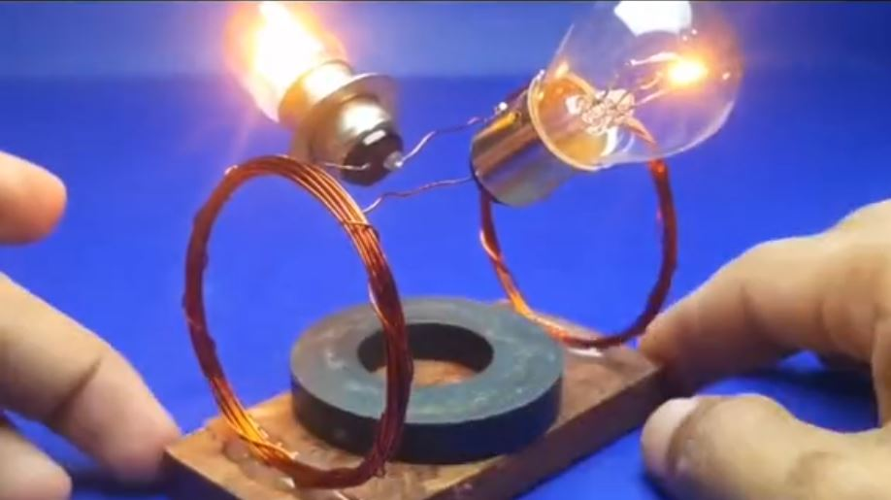

How changing the voltage changes the current
Assuming the same R, what’s the difference in current?
Ohm’s Law: $I=\frac{V}{R}$
Bigger V =>

Slide 36
How changing the voltage changes the current
Assuming the same R, what’s the difference in current?
Ohm’s Law: $I=\frac{V}{R}$
Bigger V => brighter

Slide 37
How changing the resistance changes the current
Assuming the same V, what’s the difference in current?
Ohm’s Law: $I=\frac{V}{R}$
Bigger V => brighter
Bigger R =>

Slide 38
How changing the resistance changes the current
Assuming the same V, what’s the difference in current?
Ohm’s Law: $I=\frac{V}{R}$
Bigger V => brighter
Bigger R => dimmer

Slide 39
How do you change the resistance? Configure in series
Assuming the same V, what’s the difference in current?
Original current
Ohm’s Law: $I=\frac{V}{R}$
Current here?

Slide 40
How do you change the resistance? Configure in series
Assuming the same V, what’s the difference in current?
Original current
Ohm’s Law: $I=\frac{V}{R}$
3x the original resistance

Slide 41
How do you change the resistance? Configure in series
Assuming the same V, what’s the difference in current?
Original current
Ohm’s Law: $I=\frac{V}{R}$
1/3 the original current

